Slide 1
Tennis Shots Classification With Deep Learning
MSCA 37011 Spring 2022
Vritti Gandhi, Shikhar Madrecha, Haider Waseem, Nihaal Zaveri

Slide 2
Agenda
🎾 Abstract
🎾 Exploratory Data Analysis
🎾 Modeling
🎾 Results and Future Work

Slide 3
Abstract
🎾 Goal: identify the type of tennis shots from a video
🎾 Data taken from Thetis dataset
🎾 Implemented three different models
Base CNN model
Binary classification CNN model
LRCNN

Slide 4
EDA

Slide 5
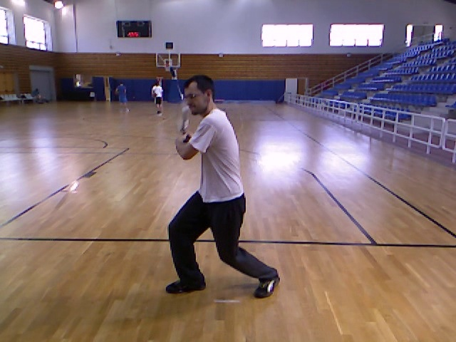
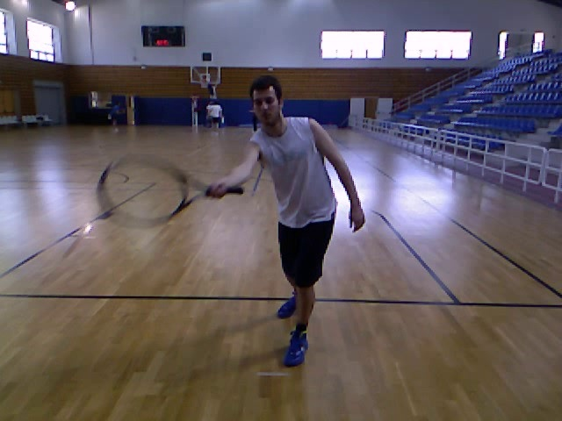
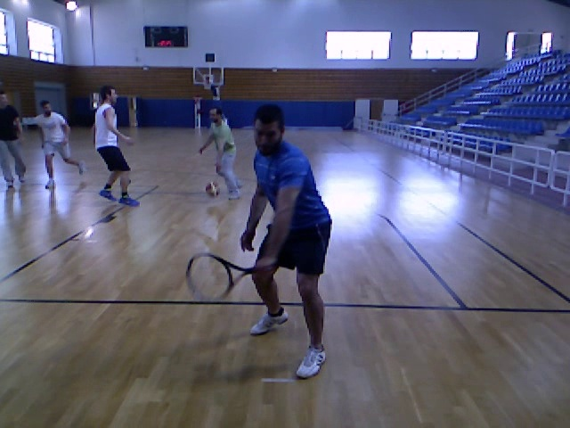
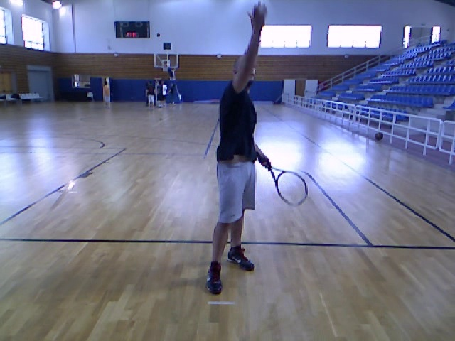
Data Dictionary
The data has been taken from THree DimEnsional TennIs Shots (THETIS) dataset.
THETIS set is comprised of a set of 12 basic Tennis shots performed by 31 amateurs and 24 experienced players. Each shot has been performed several times resulting in 1980 (single period cropped) videos, converted to AVI format. Videos were captured using an Xbox Kinect.
The total duration of the videos is 2 hours and 15 minutes.
The complete set of classes which are included in the dataset are:
backhand,
backhand 2 hands,
backhand slice,
backhand volley,
flat service,
forehand flat,
forehand open stands,
forehand slice,
forehand volley,
kick service,
slice service,
smash
Two handed backhand
Forehand Flat
One handed backhand
Smash

Slide 6
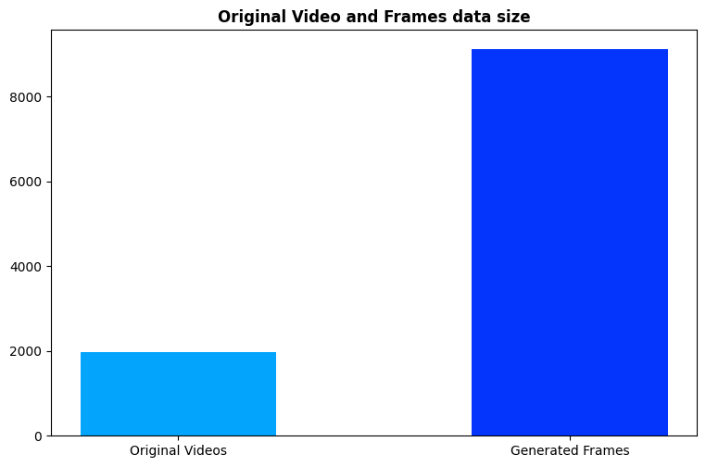
Distribution of Classes and Data Size
The THETIS dataset contains 5 second videos for each shot. To be able to input these videos in the model, we split every video in different frames and use these frames as an input into the model.
We have total 1980 videos split equally between 12 classes, i.e., 165 videos for each class.
From these videos, we extract the frame at the end of every second which leads to generation of c. 9k frames in total and around 700-800 frames for each class.

Slide 7
Extracting Frames
Method 1: Extracting the last frame of every second
0
1
2
3
4
5
There are 17 frames per second
Method 2: Extracting every 3rd frame from the middle second
5 Frames which are extracted
0
1
2
3
4
5
4 frames which are extracted from method 2. All of these frames represent the action of the shot and do not include starting and ending parts of the video which can be confusing for the model
Middle second, where the bulk of the shot action takes place
Method 3: Extracting 16 frames from the entire video
0
1
2
3
4
5
For the LRCN model, we extract 16 frames evenly spread out throughout the video.

Slide 8
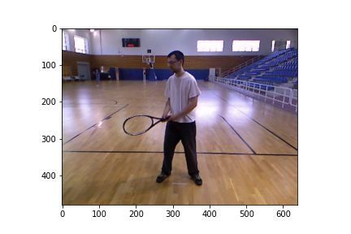

Resizing Frames
The original size of the frames extracted from videos was 480*640 pixels. This was too large to be used as an input on our local machines and was making the model run into OOM errors.
We decided to resize the images to 120*160 pixels to improve model speed and performance.
We also normalize all images by dividing the pixels by 255.

Slide 9




Infrastructure Used
As running CNNs can be computationally very expensive, we have tried variety of platforms / infrastructures to boost training and prediction speed.
RCC - Skyway
Midway

Slide 10
Modeling

Slide 11
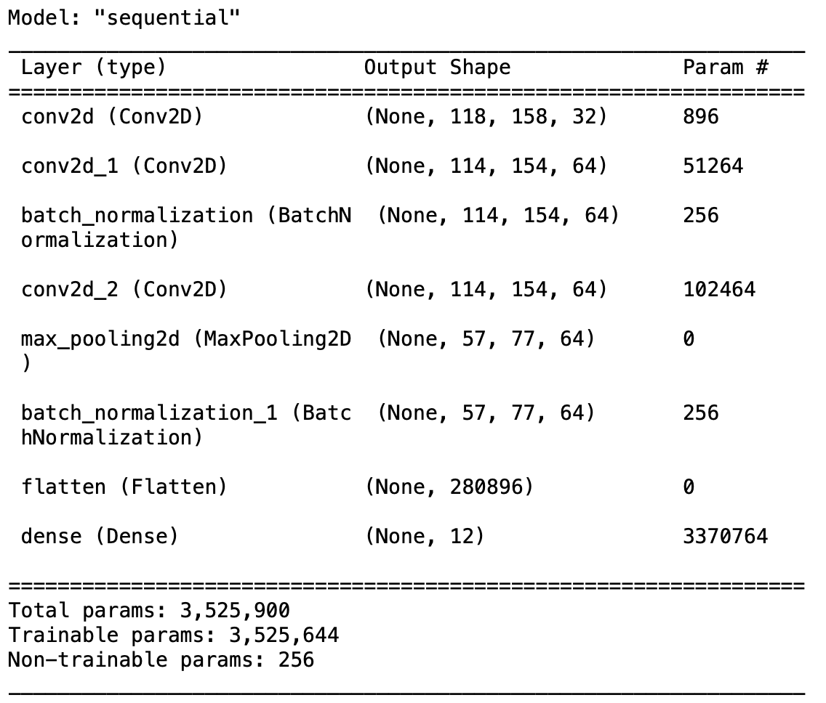
Base Model
🎾 For our baseline model, we use all 12 shot classes
🎾 We selected 200 frames of each shot type for training the model
🎾 50 frames of each shot were used for validation

Slide 12
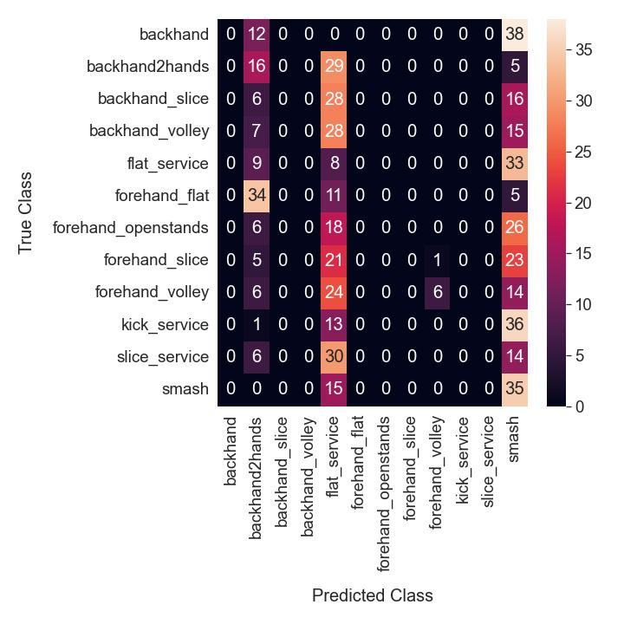
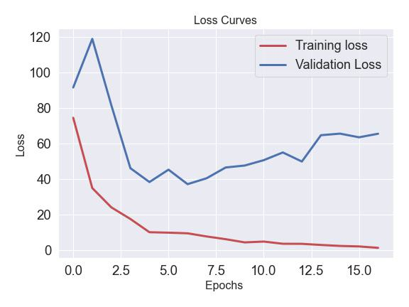

Base Model

Slide 13

Binary Classification
🎾 Instead of using all 12 shot classes, we simplified our approach to a binary classification
🎾 Groundstrokes: 2 handed
backhand and flat forehand
🎾 Service: combine three types of
serve – slice, flat, kick
🎾 1776 groundstroke frames
🎾 2553 service frames

Slide 14
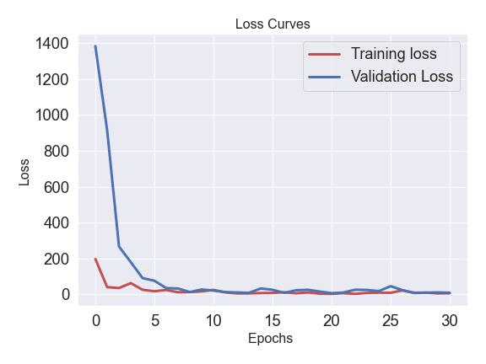
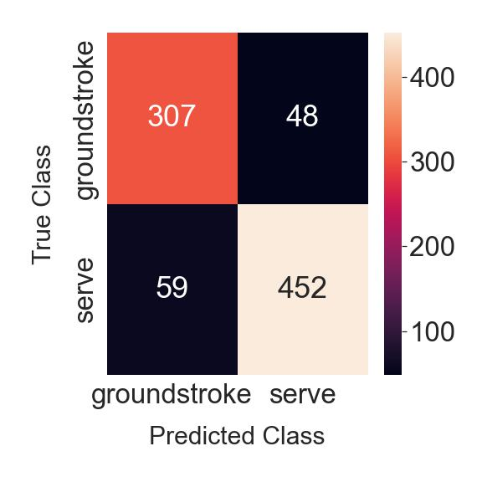

Binary Classification

Slide 15
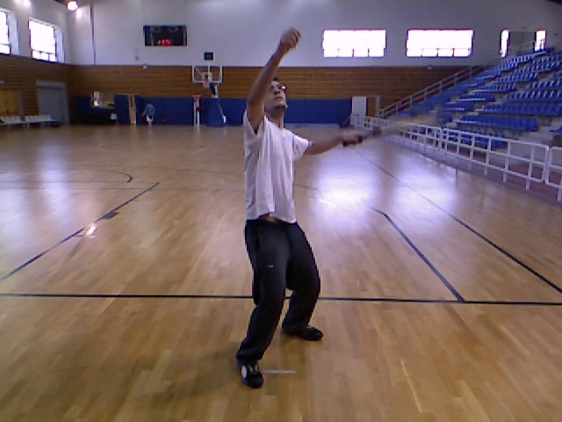


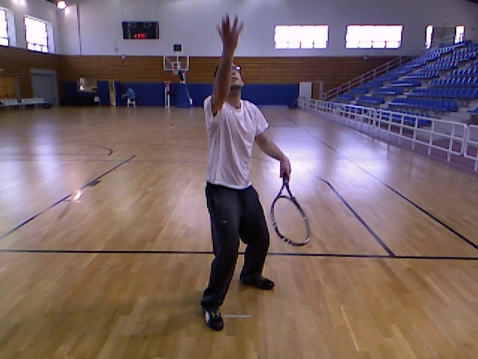
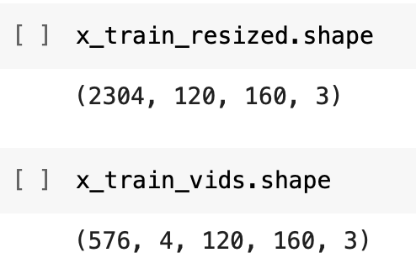
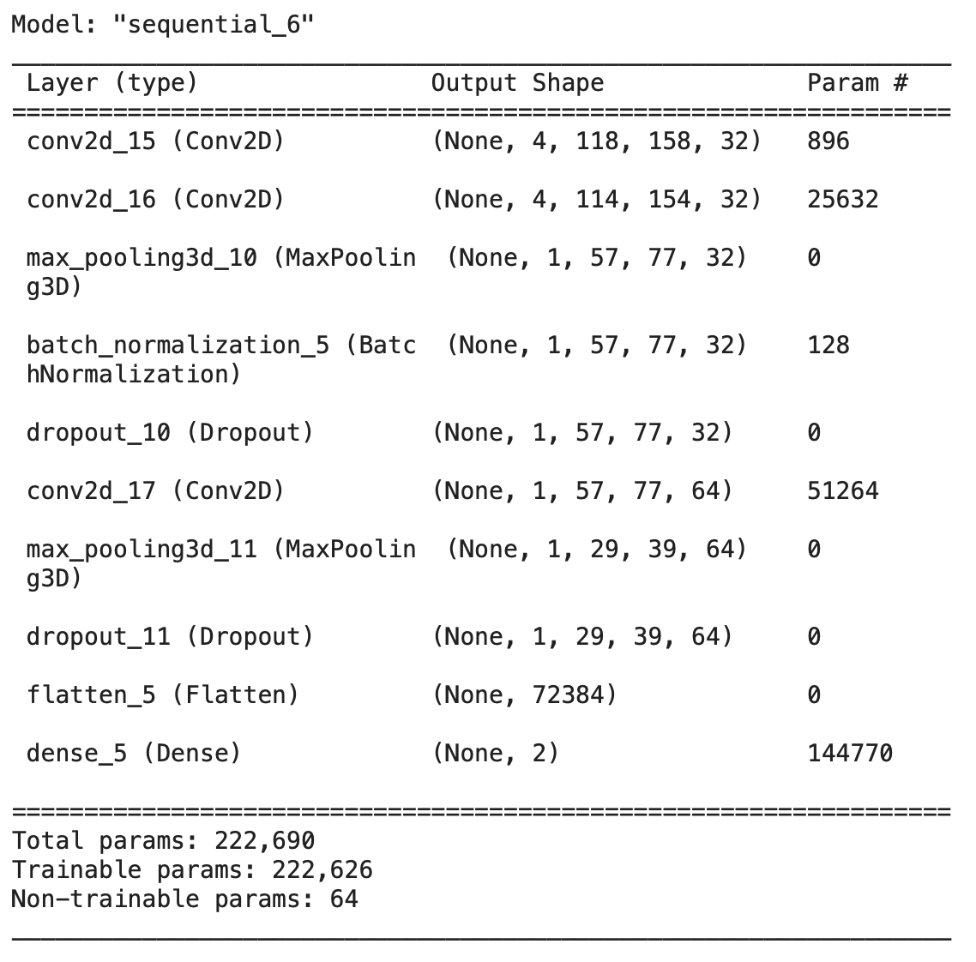
Binary Classification – 4D Input
Instead of using each frame as a single data point, we also decided to use 4 frames from each video as a single data point and created a 4-dimensional input array instead of a 3-dimension input array.
Old input array (3d)
New input array (4d)
One input
The idea behind this approach was to somehow provide a sequence of inputs in the traditional CNN architecture.
The accuracy from the binary classification problem is around 60% from this model.
Model Architecture

Slide 16
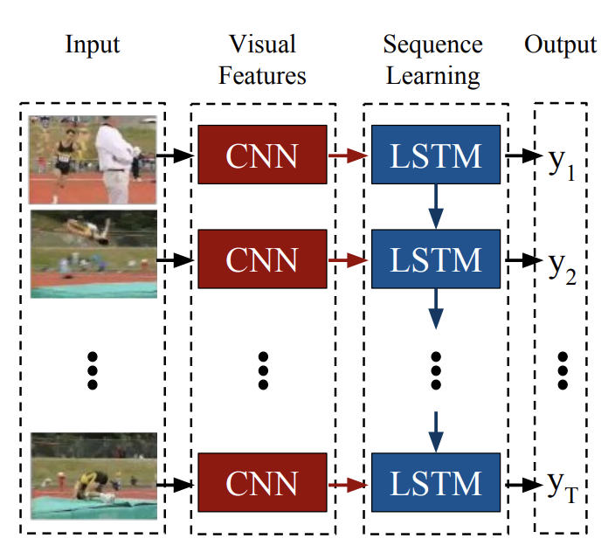
Long Term Recurrent CNN
LRCN processes the (possibly) variable-length visual input with a CNN, whose outputs are fed into a stack of recurrent sequence models. A variable-length prediction is then produced.
Both the CNN and LSTM weights are shared across time, resulting in a representation that scales to arbitrarily long sequences.

Slide 17
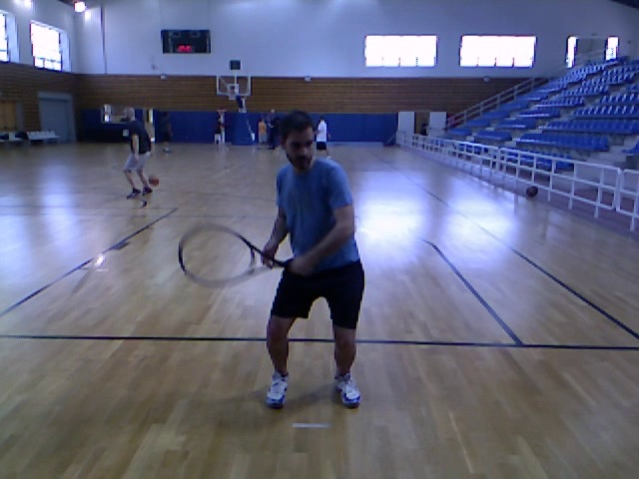
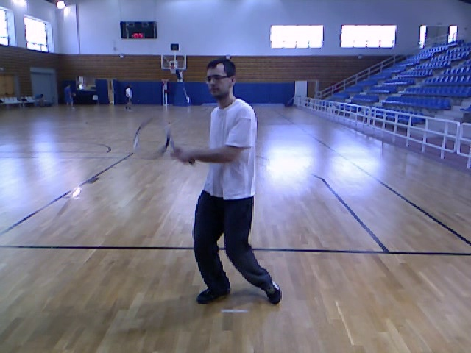
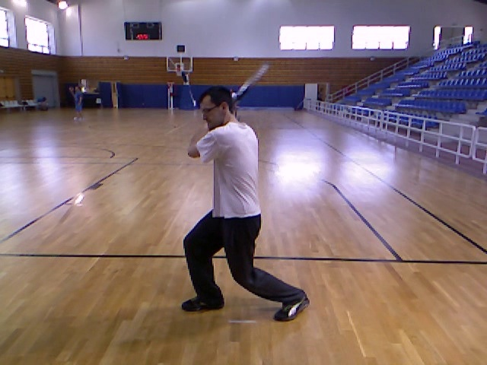
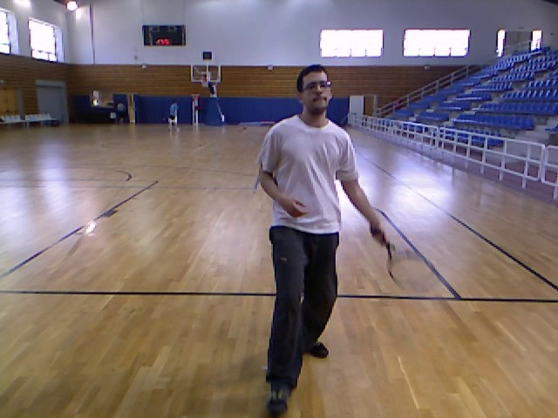
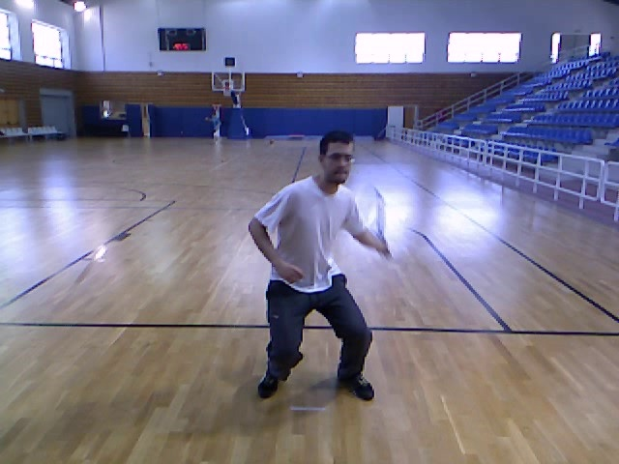
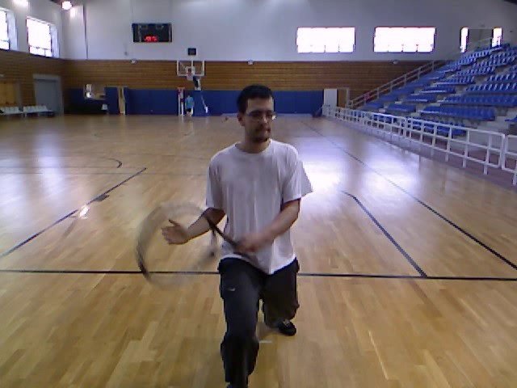
Long Term Recurrent CNN
Backhand
Backhand
Backhand Slice
Backhand2hands
Forehand
Forehand Flat
Forehand Open Stance
Forehand Slice
All serves were combined and labeled as serves. Backhand volley, forehand volley, and smash are kept separate, resulting in 6 classes.

Slide 18
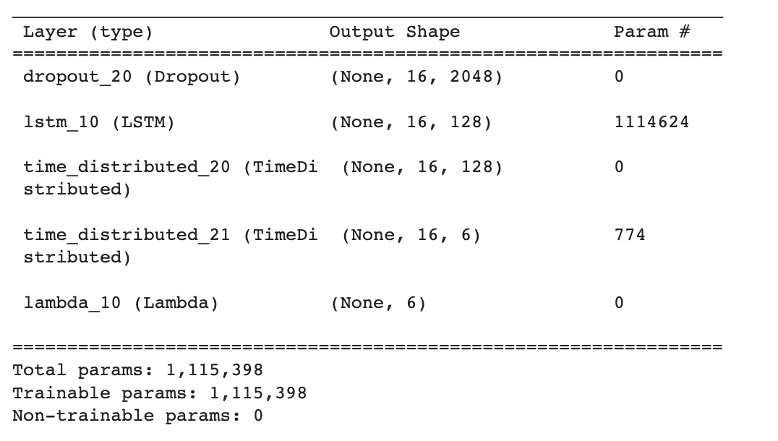
Long Term Recurrent CNN
Train, validation and test split (80-10-10)
Extraction of Frames (16 per video)
Pretrained Inception V3 as feature extractor
LSTM Model
LSTM Architecture

Slide 19
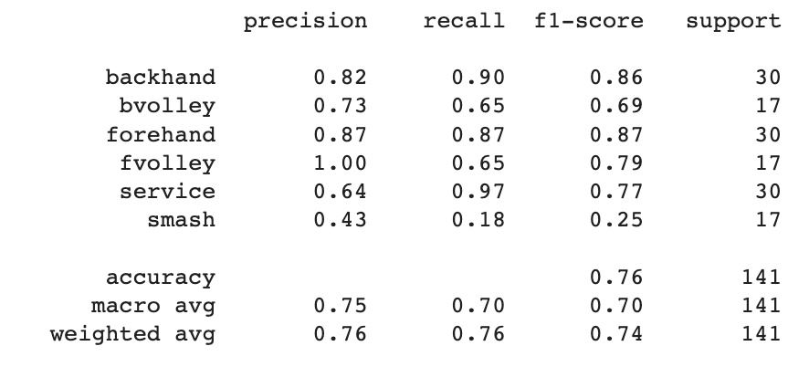
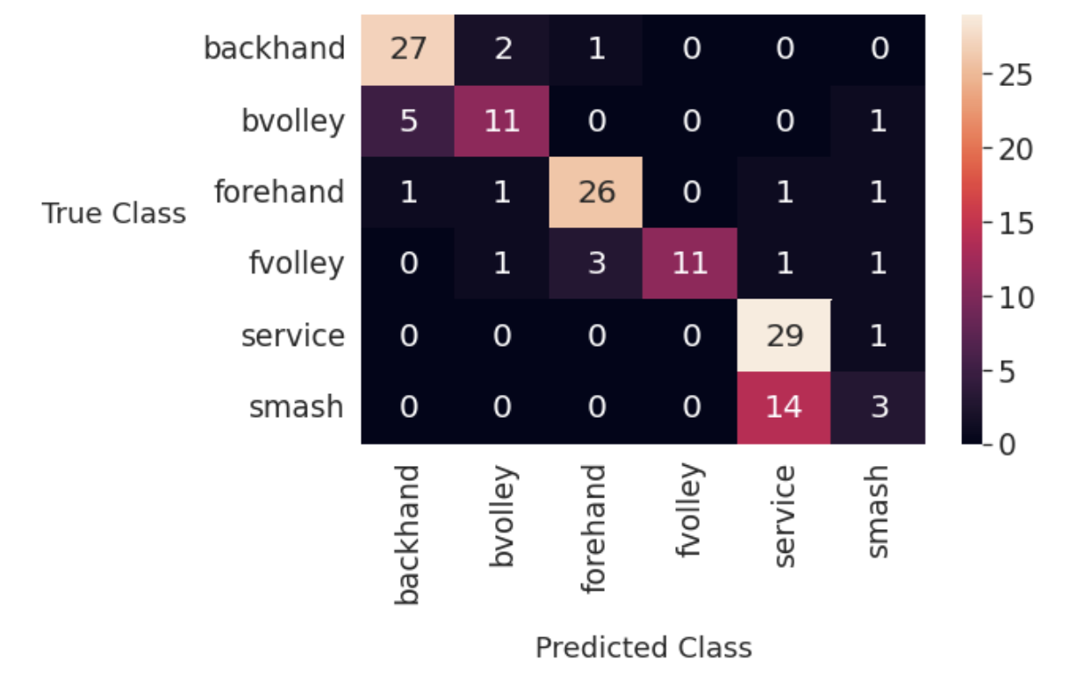
Long Term Recurrent CNN

Slide 20
Conclusion & Future Work
Model | Number of Output Classes Used | Test Accuracy
Base CNN | 12 | 11%
Binary Classification CNN | 2 | 87%
Binary Classification CNN – 4D input | 2 | 60%
LRCNN | 6 | 76%
🎾 Deploy model using Streamlit
🎾 Build more complex model in the future and identify all 12 classes
🎾 Solve overfitting problem
🎾 Solve problem of Nans in training loss of LRCNN
🎾 Have model run in real-time over a tennis video for live shot prediction

Slide 21
References
🎾 Donahue, Jeff, et al. Long-term Recurrent Convolutional Networks for Visual Recognition and Description, 2014
🎾 https://github.com/ganasank/CS230
🎾 https://github.com/chow-vincent/tennis_action_recognition
🎾 http://thetis.image.ece.ntua.gr/textfiles/thetis.pdf
🎾 http://thetis.image.ece.ntua.gr/

